Slide 1
PRIORITY QUEUE USING HEAPS
Dr.Priyanka N

Slide 2
PRIORITY QUEUE
The priority queue in the data structure is an extension of the “normal” queue
It is an abstract data type that contains a group of items
It is like the “normal” queue except that the dequeuing elements follow a priority order

Slide 3
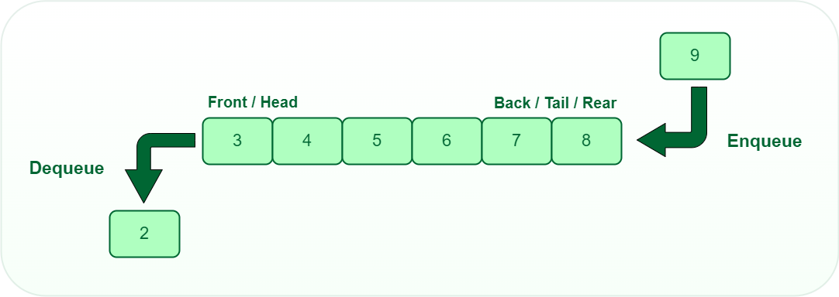
QUEUE
The “normal” queue follows a pattern of First-In-First-Out (FIFO)
It dequeues elements in the same order followed at the time of insertion operation

Slide 4
PRIORITY QUEUE
The element order in a priority queue depends on the element’s priority in that queue
The priority queue moves the highest priority elements at the beginning of the priority queue and the lowest priority elements at the back of the priority queue
It supports only those elements that are comparable
Hence, a priority queue in the data structure arranges the elements in either ascending or descending order

Slide 5
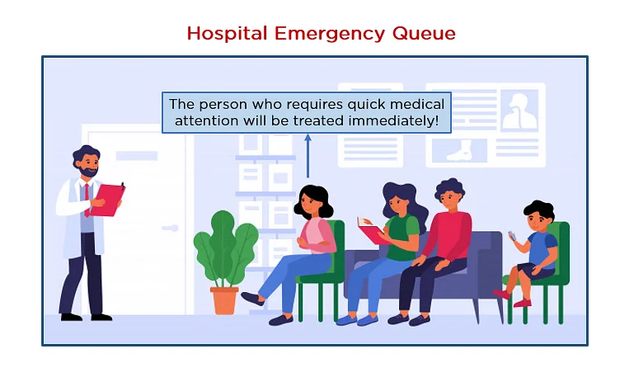
EXAMPLE
Think of a priority queue as several patients waiting in line at a hospital
Here, the situation of the patient defines the priority order
The patient with the most severe injury would be the first in the queue

Slide 6
IMPLEMENTATION OF THE PRIORITY QUEUE IN DATA STRUCTURE
Linked list
Binary heap
Arrays
Binary search tree

Slide 7
CHARACTERISTICS OF A PRIORITY QUEUE
A queue is termed as a priority queue if it has the following characteristics:
  Each item has some priority associated with it
  An item with the highest priority is moved to the front and deleted first
  If two elements share the same priority value, then the priority queue follows the First-In-First-Out principle for de-queue operation

Slide 8
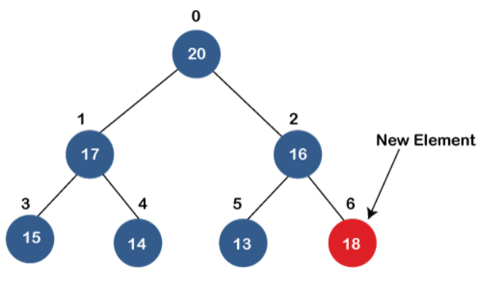
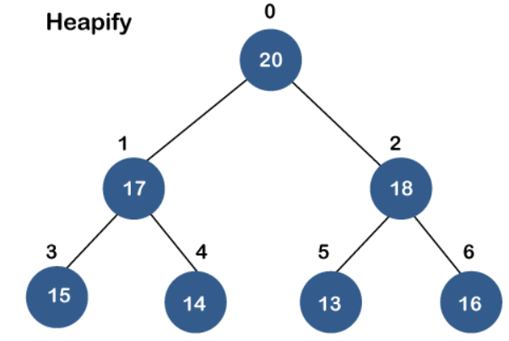
Inserting the element in a priority queue (max heap)

Slide 9
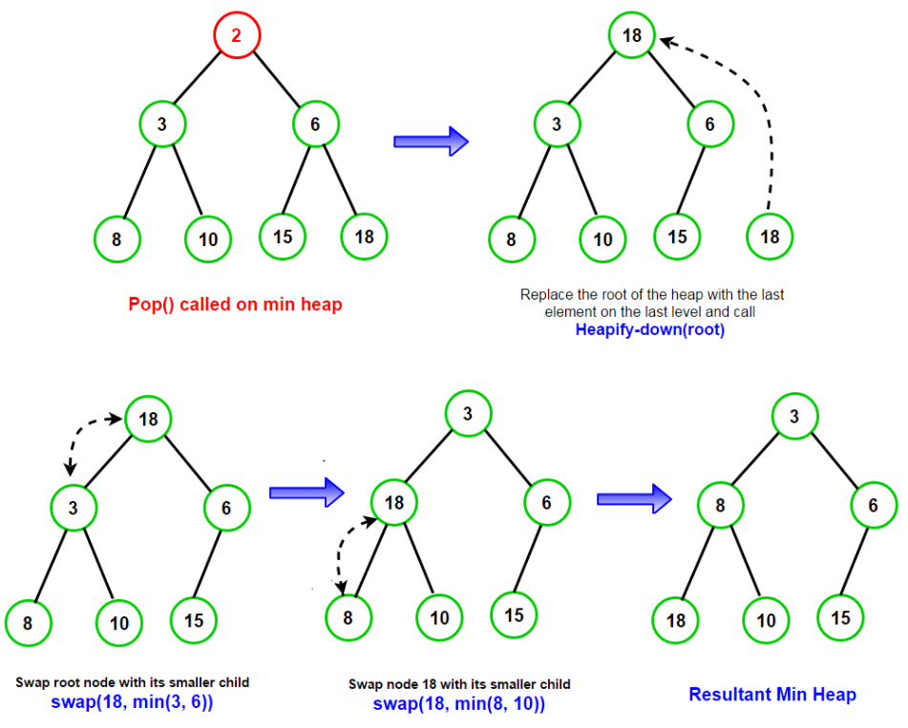
REMOVING THE MINIMUM ELEMENT FROM THE PRIORITY QUEUE

Slide 10
TYPES OF PRIORITY QUEUE
A priority queue is of two types:
    Ascending Order Priority Queue
    Descending Order Priority Queue

Slide 11
ASCENDING ORDER PRIORITY QUEUE
An ascending order priority queue gives the highest priority to the lower number in that queue
Example
Six numbers in the priority queue are 4, 8, 12, 45, 35, 20
4 | 8 | 12 | 45 | 35 | 20

Slide 12
ASCENDING ORDER PRIORITY QUEUE
Firstly, arrange the numbers in ascending order
The new list is as follows:
Here, 4 has the highest priority, and 45 has the lowest priority
4 | 8 | 12 | 20 | 35 | 45

Slide 13
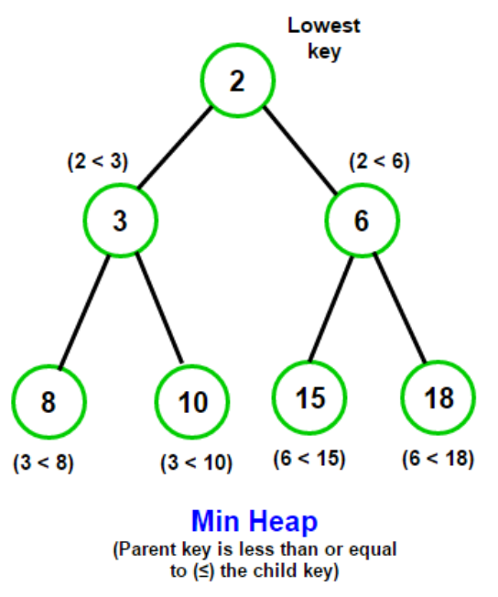
IMPLEMENTATION OF THE PRIORITY QUEUE USING BINARY HEAP
The minimum element of a priority queue is at the root of the max-heap
Return the element at the root of the heap

Slide 14
DESCENDING ORDER PRIORITY QUEUE
A descending-order priority queue gives the highest priority to the highest number in that queue
First, arrange the numbers in descending order
The new list is as follows:
Here, 45 has the highest priority, and 4 has the lowest priority
45 | 35 | 20 | 12 | 8 | 4

Slide 15
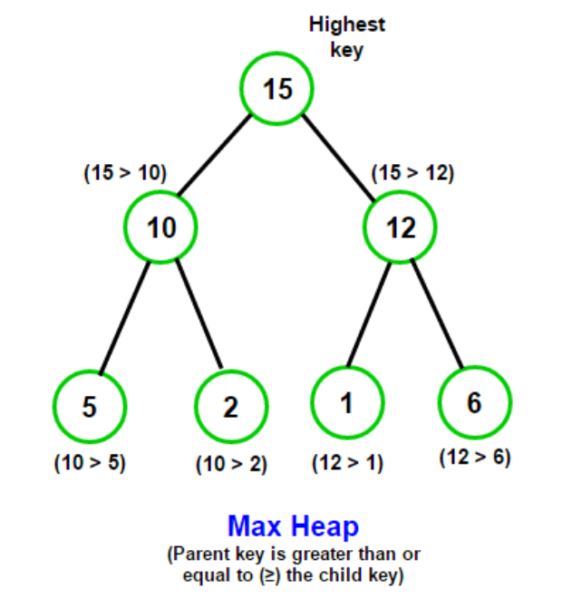
IMPLEMENTATION OF THE PRIORITY QUEUE USING BINARY HEAP
The maximum element of a priority queue is at the root of the max-heap
Return the element at the root of the heap

Slide 16
